Slide 1

Vaurlis Education
Investment Opportunity Presentation
GROWTH STAGE
EDTECH SECTOR

Slide 2
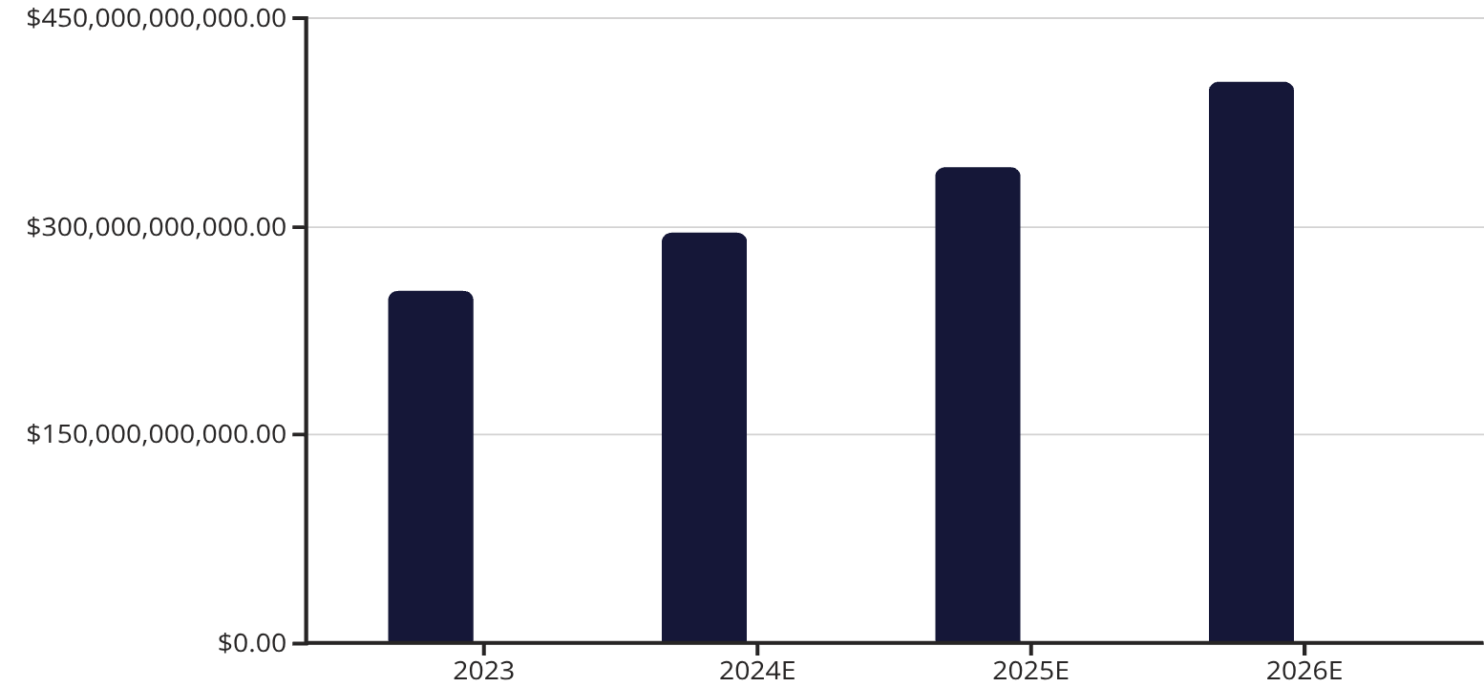
Executive Summary & Investment Thesis
Investment Highlights
Market Opportunity
Vaurlis Education represents a compelling growth opportunity in the rapidly expanding EdTech market, with strong fundamentals and scalable business model.
The global EdTech market is projected to reach $404B by 2025, growing at 16.3% CAGR. Vaurlis is capturing share in the fastest-growing segments: digital learning platforms, adaptive assessment tools, and enterprise training solutions.
1
Market Leadership
Positioned in high-growth segments with differentiated technology platform
2
Revenue Growth
Strong historical performance with clear path to profitability and scale
3
Exit Strategy
Market Size
Vaurlis Revenue
Multiple strategic and financial exit pathways within 4-6 year horizon
Vaurlis is growing 2.5x faster than market average, capturing institutional customers and expanding internationally.

Slide 3

Competitive Landscape & Financial Performance
Competitive Advantages
Key Financial Metrics
Proprietary AI Engine
73%
Patent-pending adaptive learning algorithms with 40% better outcomes than competitors
Gross Margin
Best-in-class unit economics with improving operating leverage
Customer Retention
Industry-leading 94% net retention rate with strong expansion revenue
3.2x
Strategic Partnerships
Revenue Growth
Exclusive partnerships with top-tier universities and Fortune 500 enterprises
YoY growth accelerating with expanding addressable market
$1.8M
CAC Payback
Efficient customer acquisition with 11-month payback period
Vaurlis competes against legacy LMS providers and emerging EdTech startups, differentiated by superior technology, enterprise-grade security, and comprehensive analytics. Key competitors include Coursera, Udemy Business, and traditional players like Blackboard, but none offer our integrated AI-powered personalization at scale.

Slide 4



Management Team & Risk Analysis
Sarah Chen, CEO & Founder
Michael Rodriguez, CFO
Dr. Priya Patel, CTO
Former Finance Director at Coursera through IPO. CPA with 12 years in tech finance. Scaled financial operations from $20M to $200M+ ARR.
PhD in Machine Learning from MIT. Previously led AI research at Google Education. 8 patents in adaptive learning technologies and NLP applications.
Former VP of Product at Khan Academy, 15+ years in EdTech. MBA from Stanford GSB. Led product teams serving 50M+ learners globally.
Risk Mitigation Strategy
Market Risk
Technology Risk
Competitive Risk
Regulatory Risk
Diversified revenue across K-12, higher education, and corporate segments. No single customer >8% of revenue.
Continuous R&D investment (18% of revenue), robust IP portfolio, and scalable cloud infrastructure.
Strong moats through proprietary algorithms, switching costs, and network effects from content library.
Proactive compliance team, SOC 2 Type II certified, GDPR/FERPA compliant with dedicated privacy counsel.

Slide 5


Investment Recommendation & Next Steps
The Investment Case
Next Steps
Vaurlis Education presents a rare combination of strong fundamentals, exceptional team, and massive market opportunity. Our proprietary technology platform, proven unit economics, and clear path to market leadership make this a compelling growth investment.
01
Management Presentations
Deep-dive sessions with CEO, CFO, and CTO covering strategy, financials, and technology
$50M Series B
3.5x Revenue Multiple
02
Funding for international expansion and product development
Attractive valuation vs. comparable public EdTech companies at 5-8x
Due Diligence
Access to data room, customer references, and technical architecture review
03
Site Visits
4-6 Year Horizon
Tour headquarters, meet extended team, and observe product demonstrations
Strategic exit via acquisition or IPO with projected 5-7x MOIC
04
Term Sheet
Investment Committee
14 days to negotiate key terms
Final presentation and approval process with your partnership
"Vaurlis is poised to become the definitive platform for personalized learning at scale. This is a generational opportunity in EdTech."
Closing & Onboarding
Due Diligence
45 days to finalize and integrate
30 days of financial and legal review
Our accelerated timeline enables rapid deployment of capital to capture market share during this critical growth phase.

